Slide 1

Algorithm Design and Analysis

Slide 2
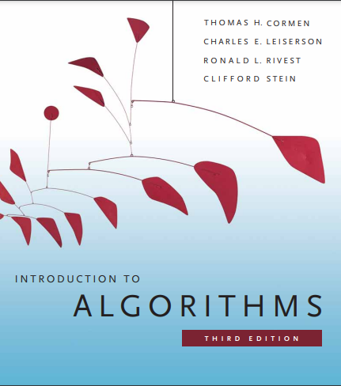
Algorithm Design and Analysis

Slide 3
Chapter 5: Greedy Algorithms

Slide 4
Optimization problem
In mathematics and computer science, an optimization problem is the problem of finding the best solution from all feasible solutions.
Examples
The minimum cost for travelling from city A to City B.
The minimum waiting time to process several processes where each process has a different execution time.
Maximizing the revenue in a factory the produces different items, with different prices, and different production time.
Usually, optimization problems are handled through these types of algorithms:
Greedy methods
Dynamic programming
Branch and bound algorithms

Slide 5

Optimization problem

Slide 6


Optimization problem

Slide 7
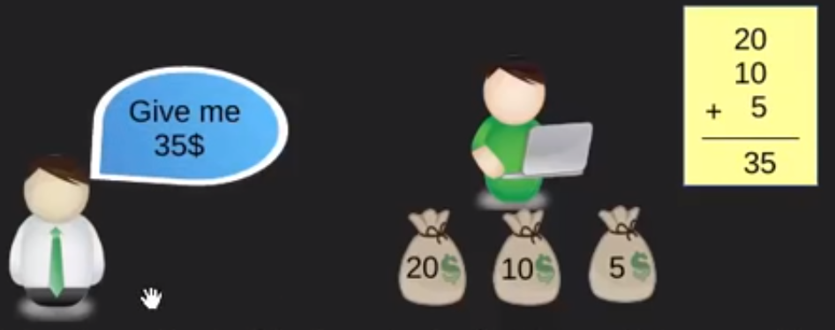
Optimization problem
Here, the thing to note is that:
After each iteration, he is making an optimal local choice, a choice that is greedy in its nature, hoping to find the optimal global choice for solving the problem.

Slide 8
Greedy Algorithms
Greedy algorithms: an algorithmic paradigm that follows the problem solving approach of making the locally optimal choice at each stage with the hope of finding a global optimum.
Pros: simple, easy to implement, run fast
Cons: very often they do not provide a globally optimum solution

Slide 9
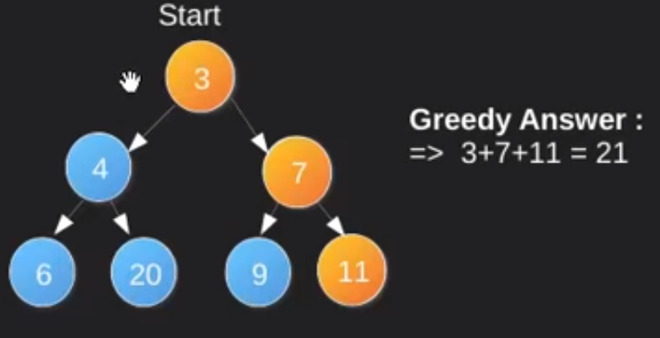
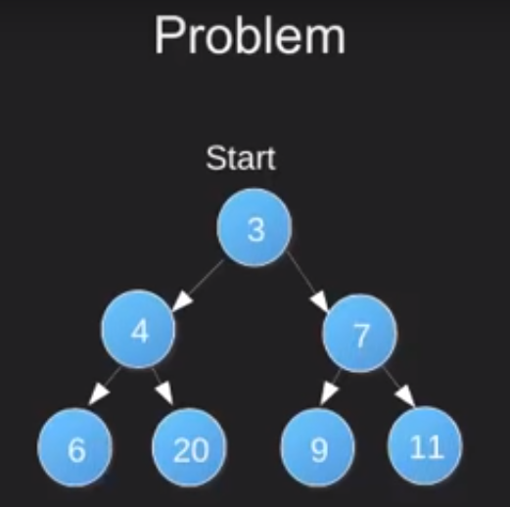
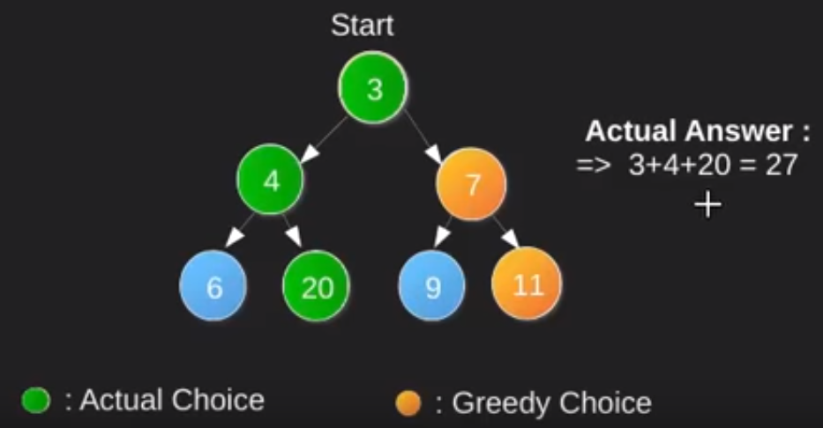
Example
With this example, we will see how greedy algorithms makes locally optimal choices. However, ending up at a non optima solution.
The problem is to find the largest sum from the root to a leaf
Conclusion: making optimal locally greedy choices do not always leads to a global optimal choice.

Slide 10
Greedy Algorithms Applications
Scheduling:
    Activity Selection Problem
    Job Scheduling Problem
Graph Algorithms
  Minimum Spanning Tree
    Prime Algorithm
    Kruskal's Algorithm
  Shortest path
    Dijkstra Algorithm
Other Optimization Problems
    Fractional Knapsack problem

Slide 11


Activity Selection Problem
In the activity-selection problem, we wish to select a maximum-size subset of mutually compatible activities. We assume that the activities are sorted in monotonically increasing order of finish time:
For example
consider the following set S of activities:
For this example, the subset{a3, a9, a11} consists of mutually compatible activities. It is not a maximum subset, however, since the subset {a1, a4, a8, a11} is larger. In fact, {a1, a4, a8, a11} is a largest subset of mutually compatible activities; another largest subset is {a2, a4, a9, a11}.

Slide 12
Making the greedy choice
In fact, for the activity-selection problem, we need consider only one choice: the greedy choice in order to leave the resource available for as many other activities as possible by choosing the activity in S with the earliest finish time (a1).
If we make the greedy choice, we have only one remaining subproblem to solve: finding activities that start after a1 finishes. Thus, all activities that are compatible with activity a1 must start after a1 finishes.
Optimal substructure tells us that if a₁ is in the optimal solution, then an optimal solution to the original problem consists of activity a₁ and all the activities in an optimal solution to the subproblem S₁.
Greedy algorithms typically have a top-down design
  make a choice and then solve a subproblem, rather than the bottom-up technique of solving subproblems before making a choice.

Slide 13
Example 1:
Problem: Given n activities with their start and finish times. Select the maximum number of activities that can be performed by a single person, assuming that a person can only work on a single activity at a time.
Activity | A1 | A2 | A3
Start | 12 | 10 | 20
Finish | 25 | 20 | 30
1. Sort the activities according to their Finishing time
Activity | A1 | A2 | A3
Start | 10 | 12 | 20
Finish | 20 | 25 | 30
2. Select the optimal local solution one by one as following
A1 → A3 Total Activities = 2

Slide 14
Example 2:
Problem: Given n activities with their start and finish times. Select the maximum number of activities that can be performed by a single person, assuming that a person can only work on a single activity at a time.
Activity | A1 | A2 | A3 | A4 | A5 | A6
Start | 0 | 3 | 1 | 5 | 5 | 8
Finish | 6 | 4 | 2 | 9 | 7 | 9
Solution steps:
1. Sort the activities according to their finishing time.
Activity | A3 | A2 | A2 | A5 | A6 | A4
Start | 1 | 3 | 0 | 5 | 8 | 5
Finish | 2 | 4 | 6 | 7 | 9 | 9

Slide 15
Activity selection problem - Code
2. Select the first activity from the sorted array
3. Do the following for the remaining activities in the sorted array:
  If the start time of this activity is greater than or equal to the finish time of the previously selected activity then select this activity.
A3 ➔ A2 ➔ A5 ➔ A6 Total Activities = 4

Slide 16
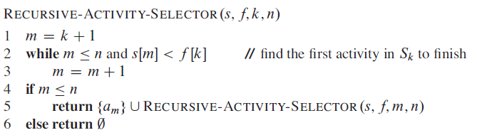
Activity Selection - Code

Slide 17
Fractional Knapsack Problem
The 0-1 knapsack problem is the following. A thief robbing a store finds n items. The i th item is worth i dollars and weighs w_{i} pounds, where i and w_{i} are integers. The thief wants to take as valuable a load as possible, but he can carry at most W pounds in his knapsack, for some integer W. Which items should he take?
(We call this the 0-1 knapsack problem because for each item, the thief must either take it or leave it behind; he cannot take a fractional amount of an item or take an item more than once.)
In the fractional knapsack problem, the setup is the same, but the thief can take fractions of items, rather than having to make a binary (0-1) choice for each item. You can think of an item in the 0-1 knapsack problem as being like a gold ingot and an item in the fractional knapsack problem as more like gold dust.

Slide 18
Fractional Knapsack Problem
Although the problems are similar, we can solve the fractional knapsack problem by a greedy strategy, but we cannot solve the 0-1 problem by such a strategy.
To solve the fractional problem, we first compute the value per pound vi/w_{i} for each item. Obeying a greedy strategy, the thief begins by taking as much as possible of the item with the greatest value per pound. If the supply of that item is exhausted and he can still carry more, he takes as much as possible of the item with the next greatest value per pound, and so forth, until he reaches his weight limit W.

Slide 19
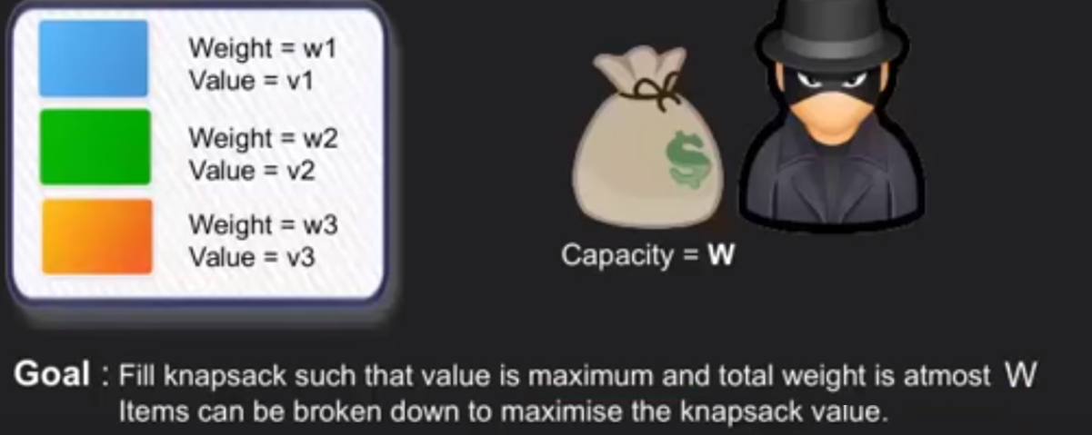
Problem

Slide 20
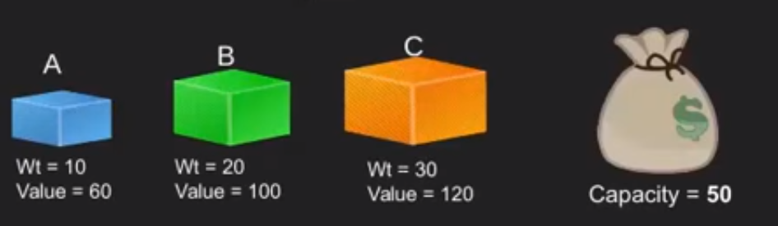
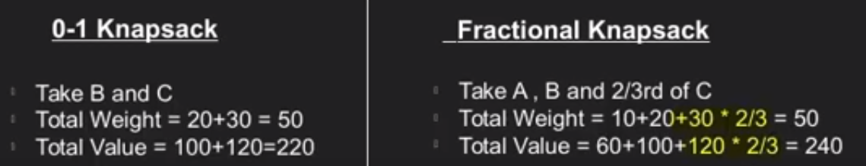
Solution

Slide 21
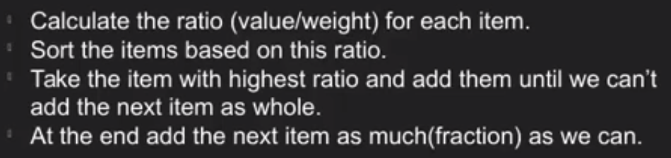
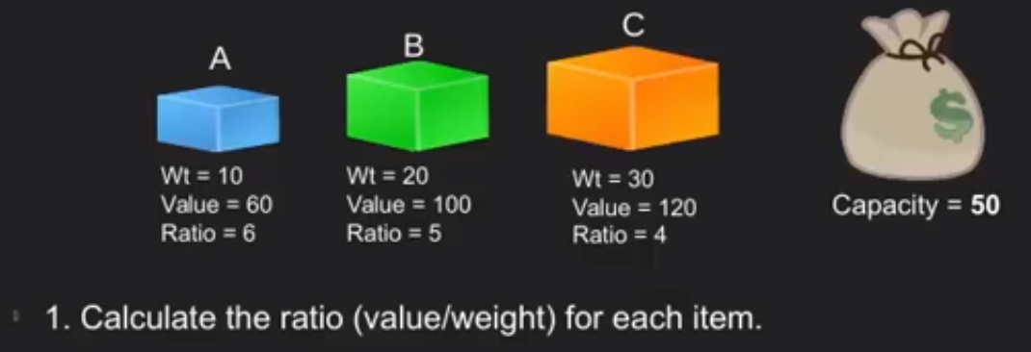
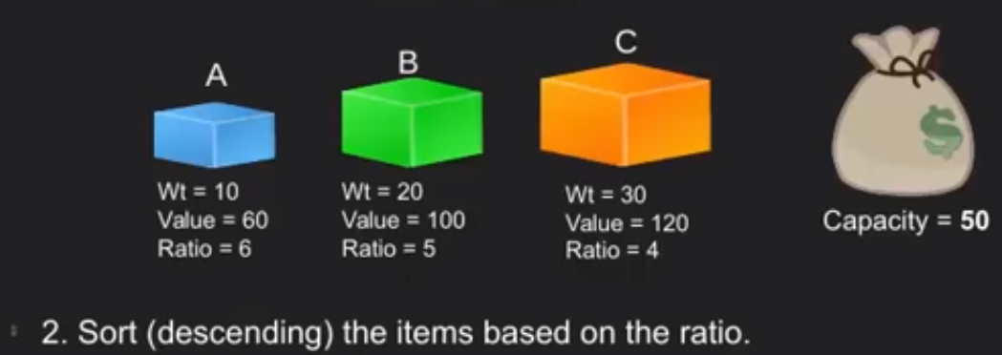
Greedy Solution

Slide 22
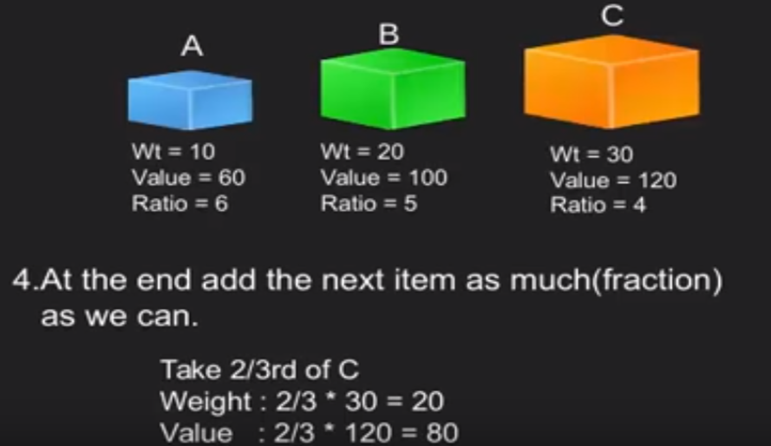
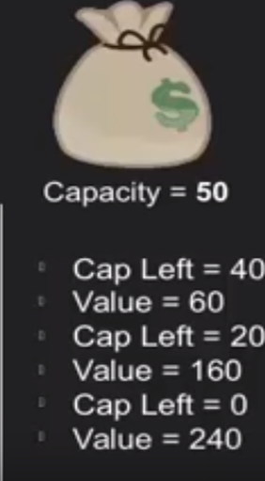
3. We select A (as a whole), then B (as a whole), then C (2/3 of C)

Slide 23
Spanning Tree
A Tree is a connected undirected graph that contains no cycles is called a tree
A Spanning Tree of a graph G is a subgraph of G that is a tree and contains all the vertices of G
Properties
  The spanning tree of a n –vertex Undirected Graph has exactly n-1 edges
  It connects all the Vertices in the Graph
  A Spanning tree has no Cycles
A
B
A
B
A
B
C
C
C
D
D
D
E
E
E
Undirected Graph
Some Spanning Trees

Slide 24
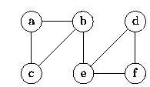
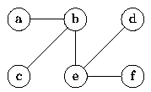
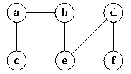
Constructing Spanning Trees
Any traversal of a connected, undirected graph visits all the vertices in that graph. The set of edges which are traversed during a traversal forms a spanning tree.
(a) Graph G
Figure (b) shows the spanning tree obtained from a breadth-first traversal starting at vertex b.
(b) Breadth-first spanning tree of G rooted at b
Similarly, Figure (c) shows the spanning tree obtained from a depth-first traversal starting at vertex c.
(c) Depth-first spanning tree of G rooted at c

Slide 25
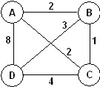
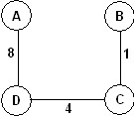
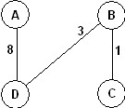
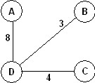
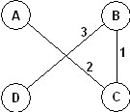
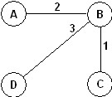
What is a Minimum-Cost Spanning Tree
For an edge-weighted , connected, undirected graph, G, the total cost of G is the sum of the weights on all its edges.
A minimum-cost spanning tree for G is a minimum spanning tree of G that has the least total cost.
Example: The graph
Has 16 spanning trees. Some are:
The graph has two minimum-cost spanning trees, each with a cost of 6:

Slide 26
Minimum-Cost Spanning Trees
Some applications of Minimum_cost Spanning Tree:
  Building cable networks that join n locations with minimum cost.
  Building a road network that joins n cities with minimum cost.
  Obtaining an independent set of circuit equations for an electrical network.
  In pattern recognition minimal spanning trees can be used to find noisy pixels.
Some Greedy Algorithms that used for finding the Minimum_cost Spanning Tree
  Prim’s algorithm
  Kruskal’s algorithm

Slide 27
Prim’s Algorithm
It is a Vertex based algorithm.
The tree starts from an arbitrary root vertex r and grows until the tree spans all the vertices in V.
At each step, add to the tree A the edge that connects A to an isolated vertex of G_{A} = (V, A).
  Adds only edges that are safe for A.
  When algorithm terminates, edges in A form MST.
  MST A for G: A={(v, p[v]): v ε V-{r}}.
Grows one tree T, one vertex at a time

Slide 28
Prim’s Algorithm - Code
MST-Prim(G,w,r) //G is a graph with weight w and a root vertex r
1 for each u ∈ V[G]
2 key[u] ← ∞
3 p[u] ← NIL
4 key[r] ← 0
5 Q = ∅ // Q is a Queue of all vertices out of tree T
6 for each vertex u ∈ G.V
7 INSERT(Q, u) // add u to T
8 while Q ≠ ∅ do
u ← ExtractMin(Q) // take the vertex with minimum key
for each v ∈ Adj[u] do
9 if v ∈ Q and w(u,v) < key[v] then
10 p[v] ← u
11 key[v] ← w(u,v)
// update keys of u’s neighbors not in T

Slide 29
Prim’s Algorithm - Example

Slide 30
Prim’s Algorithm - Example

Slide 31
Prim’s Algorithm - Example

Slide 32
Prim’s Algorithm - Example

Slide 33
Prim’s Algorithm - Example

Slide 34
Prim’s Algorithm - Example

Slide 35
Prim’s Algorithm - Example

Slide 36
Prim’s Algorithm - Example

Slide 37
Prim’s Algorithm - Example

Slide 38
Prim’s Algorithm - Example

Slide 39
Prim’s Algorithm - Example

Slide 40
Prim’s Algorithm - Example

Slide 41
Prim’s Algorithm - Example

Slide 42
Prim’s Algorithm - Example

Slide 43
Prim’s Algorithm - Example

Slide 44
Prim’s Algorithm - Example

Slide 45
Prim’s Algorithm - Example

Slide 46
Prim’s Algorithm - Example

Slide 47
Prim’s Algorithm - Example

Slide 48
Prim’s Algorithm - Example

Slide 49
Prim’s Algorithm – Complexity analysis
MST-Prim(G,w,r)
1 for each u ∈ V[G]
2 key[u] ← ∞
3 p[u] ← NIL
4 key[r] ← 0
5 Q = ∅
6 for each vertex u ∈ G.V
7 INSERT(Q, u)
8 while Q ≠ ∅ do
u ← ExtractMin(Q)
for each v ∈ Adj[u] do
9 if v ∈ Q and w(u,v) < key[v] then
10 p[v] ← u
11 key[v] ← w(u,v)
while loop is executed |V| times
Extract-Min is executed |V| times
Decrease-Key is executed O(|E|) times

Slide 50
Prim’s Algorithm – Complexity analysis
Time complexity depends on data structure Q
Binary heap: O(E lg V):
  BuildHeap takes O(V) time
  number of “while” iterations: V
    ExtractMin takes O(lg V) time
  total number of “for” iterations: E
    DecreaseKey takes O(lg V) time
Hence,
  Time = V + V. T(ExtractMin) + E. T(DecreaseKey)
  Time = O(V lg V + E lg V) = O(E lg V)
    Since E ≥ V – 1 (because G is connected)

Slide 51
Kruskal's Algorithm
Edge based algorithm
Kruskal’s algorithm also finds the minimum cost spanning tree of a graph by adding edges one-by-one.
Pseudocode
enqueue edges of G in a queue in increasing order of cost.
T = φ ;
while(queue is not empty){
dequeue an edge e;
if(e does not create a cycle with edges in T)
add e to T;
}
return T;

Slide 52
Kruskal's Algorithm
INPUT:
  edge-weighted graph G = (V, E), with |V| = n
OUTPUT:
  a spanning tree T of G
    touches all vertices,
    has n-1 edges
    of minimum cost ( = total edge weight)
Algorithm:
  Start with T empty,
  Add the edges one at a time, in increasing weight order
  An edge is accepted it if connects vertices of distinct trees (if the edge does not form a cycle in T)
  until T contains n-1 edges

Slide 53
Data Structures For Kruskal’s Algorithm
Initially, T is empty
Initial sets are:
  {1} {2} {3} {4} {5} {6} {7} {8}
Does the addition of an edge (u, v) to T result in a cycle? If not, add edge to T
  s₁ = Find-Set(u); s₂ = Find-Set(v);
  if (s₁ ≠ s₂) then Union(s₁, s₂);
1
3
5
7
2
4
6
8

Slide 54
Kruskal's Algorithm Code
MST-Kruskal(G,w)
1 T ← ∅
2 for each vertex v ∈ V[G] do
3 Make-Set(v)
4 sort the edges of E by nondecreasing weight w
5 for each (u,v)∈E, in nondecreasing of weight do
6 if Find-Set(u) ≠ Find-Set(v) then
7 T ← T ∪ {(u,v)}
8 Union(Set(u),Set(v))
9 return T

Slide 55
Kruskal’s Algorithm
Mark each vertex as being in a Set
Initially each vertex is in a set of it’s own
Sort the edges in increasing order of the weight
Take the edges in the sorted order (smallest one first)
  If it’s Safe to add the edge
  Add it to the tree, don’t worry about the overall structure
It is Safe to connect to vertices from different sets, No Cycles will be formed.
Our implementation of Kruskal’s algorithm uses a disjoint-set data structure to maintain several set of elements.
Each set contains the vertices in a tree of the current forest.
The operation Find-Set(u) returns a representative element from the set that contains u.
Thus, we can determine whether two vertices u and v belong to the same tree by testing whether Find-Set(u)=Find-Set(v).
The combining of trees is accomplished by the Union() procedure.

Slide 56
Kruskal’s Algorithm (Contd.)
To implement a disjoint-set forest with the union-by-rank heuristic, we must keep track of ranks.
With each node x, we maintain the integer value rank[x], which is an upper bound on the height of x.
When a singleton set is created by Make-Set(), the initial rank of the single node in the corresponding tree is 0.
Each Find-Set() operation leaves all ranks unchanged.
When applying Union() to two trees, there are two cases, depending on whether the roots have equal rank.
If unequal ranks, we make root of the higher rank the parent of the root of other, but their ranks remain same.
If equal ranks, we arbitrarily choose one of the roots as the parent and increment its rank.

Slide 57
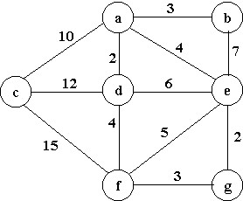
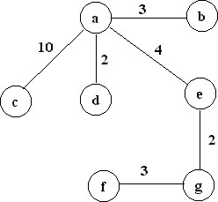
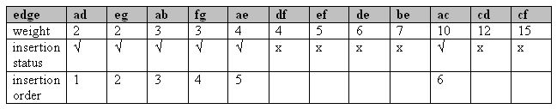
Kruskal’s algorithm Example
Trace Kruskal's algorithm in finding a minimum-cost spanning tree for the undirected, weighted graph given below:
The minimum cost is: 24

Slide 58
Kruskal’s Algorithm Complexity analysis
Kruskal’s Algorithm consists of two stages.
  Initializing the set A in line 1 takes O(1) time.
  Sorting the edges by weight in line 4.
    takes O(E lg E)
  Performing
    |V| MakeSet() operations // for loop in lines 2-3.
    |E| FindSet(), //for loop in lines 5-8.
    |V| - 1 Union(), //for loop in lines 5-8.
    which takes O(V + E)
The total running time is
  O(E lg E)
  Observing that │E │< │V│² we have lg │E│ = O(lg V), So total running time becomes O(E lg V).

Slide 59
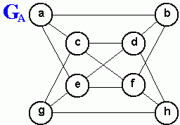
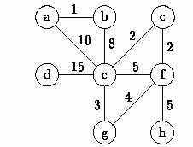
Review Questions
Using the following graphs answer the question 1 - 3
G_{B}
Find the breadth-first spanning tree and depth-first spanning tree of the graph G_{A} shown above.
For the graph G_{B} shown above, trace the execution of Prim's algorithm as it finds the minimum-cost spanning tree of the graph starting from vertex a.
Repeat question 2 above using Kruskal's algorithm.

Slide 60
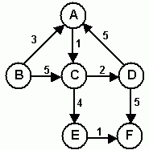
Shortest path problem
In an edge-weighted graph, the weight of an edge measures the cost of traveling that edge.
  For example, in a graph representing a network of airports, the weights could represent: distance, cost or time.
  Such a graph could be used to answer any of the following:
    What is the fastest way to get from A to B?
    Which route from A to B is the least expensive?
    What is the shortest possible distance from A to B?
Each of these questions is an instance of the same problem:
The shortest path problem!
Shortest path problem is the problem of finding a path between two nodes in a graph such that the sum of the weights of its constituent edges is minimized.
If all the edges in a graph have non-negative weights, then it is possible to find the shortest path from any two vertices.
  For example, in the figure below, the shortest path from B to F is { B, A, C, E, F } with a total cost of nine.
  Thus, the problem is well defined for a graph that contains non-negative weights.
There exist Several well known algorithms for solving the shortest path problem and its variants like Dijkstra's Algorithm.

Slide 61
The Dijkstra's Algorithm
Dijkstra’s Algorithm uses the Greedy Method
It is a very Efficient Algorithm to calculate the Shortest Path for a non-negative weights graph.
It finds the shortest path from an initial vertex, say s, to all the other vertices.
  The algorithm maintains a set S of vertices whose final shortest-path weights from source s have already been determined.
  Take the adjacent nodes and update the current shortest distance.
  The algorithm repeatedly selects the vertex u ϵ V-S, with minimum shortest distance estimated.
  Update the current shortest distance of the adjacent vertices where necessary.
    i.e. when the new distance is less than the existing value.
  Stop when all the Vertices are checked.

Slide 62
The Dijkstra's Algorithm_Code
// Let V be the set of all vertices in G, and s the start vertex.
for each vertex v {
currentDistance(s-v) = ∞;
predecessor(v) = undefined;
}
currentDistance(s-s) = 0;
T = V;
while(T ≠ φ){
v = a vertex in T with minimal currentDistance from s;
T= T – {v};
for(each vertex u adjacent to v and in T){
if(currentDistance(s-u) > currentDistance(s-v) + weight(edge(vu)){
currentDistance(s-u) = currentDistance(s-v) + weight(edge(vu));
predecessor(u) = v;
} } }
For each vertex, the algorithm keeps track of its current distance from the starting vertex and the predecessor on the current path

Slide 63
The Dijkstra's Algorithm_Complexity analysis
The running time of the Dijkstra’s Algorithm depends on how the min-priority queue is implemented.
  The for loop in the initialization step, takes |V| times.
  The while loop executed |v| times.
  Each Extract-Min() operation takes |V| time.
  Each edge in the adjacency list Adj[v] is examined in the for loop inside the while loop exactly once during the course of the algorithm.
    Since the total number of edges in adjacency list is |E|, there are a total of |E| iterations of this for loops. So, the total running time is O(V²+E)=O(V²).
  If the graph is sufficiently sparse, it is practical to implement min-priority queue with a binary min-heap.
    the total running time is O(E lg V).

Slide 64
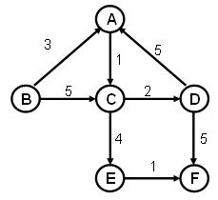
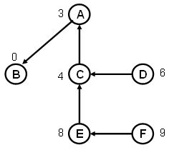
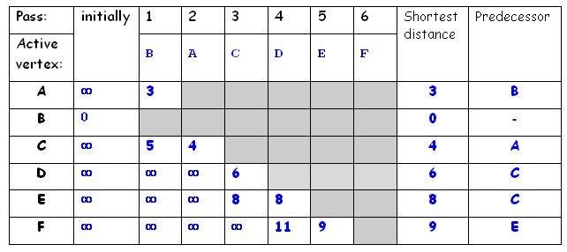
The Dijkstra's Algorithm_ Example
Tracing Dijkstra’s algorithm starting at vertex B:
The resulting vertex-weighted graph is:

Slide 65
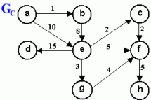
Review Question
Use the graph Gc shown above to trace the execution of Dijkstra's algorithm as it solves the shortest path problem starting from vertex a.

